Slide 1
Market in NetLogo
Jordi Bonet Valiente
Clara Rivadulla Duró

Slide 2
Index
Introduction
Motivation and description of the simulated system
The interaction protocols
The interface design
Experiments and results
Analysis and conclusions
Future work

Slide 3
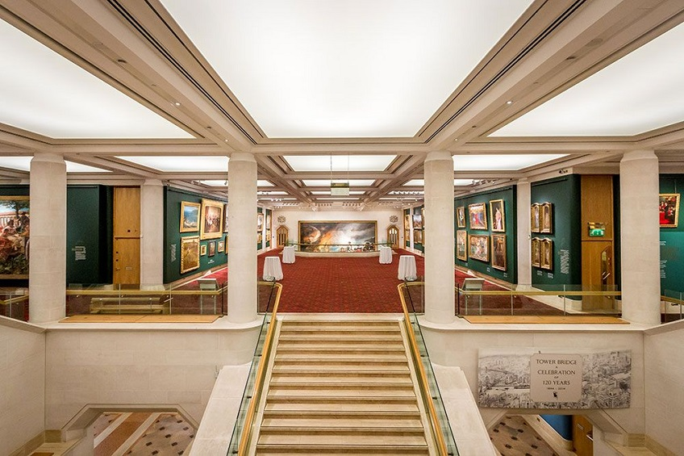

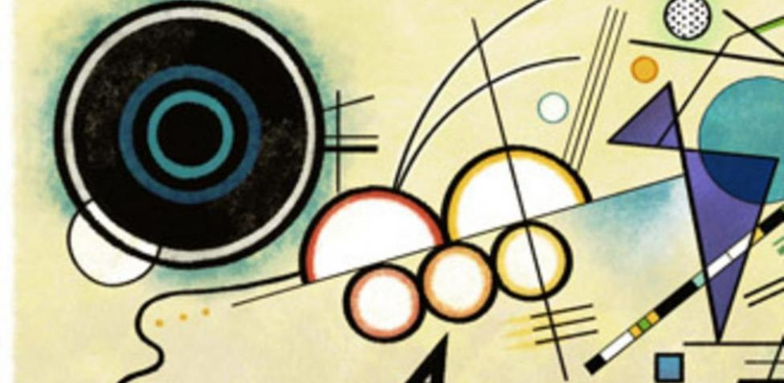
Introduction
We have decided to model our market as a commerce transaction between art galleries and collectors, where the sold / bought products are paintings.

Slide 4
Motivation and description of the system
Which market?
Art (paintings).
Which agents?
Art galleries (of Madrid and Albacete) and collectors (1, 2, 3, 4).
How should agents interact with each other?
Talking and negotiating in a bilateral way (peer to peer).

Slide 5
Interaction protocols
We have designed our communication protocol depending on the success or the failure of the advertisement presented by the art gallery.
Advertisement attributes in order to compare them with customer’s preferences: author and price.
Example:

Slide 6
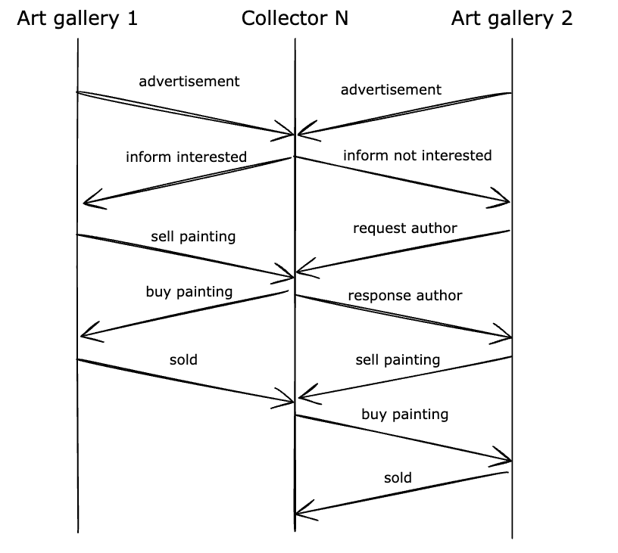
Interaction protocols. Optimal cases
This diagram represents the optimal cases of our communication protocol, where the collector ends up buying a painting from both galleries.
These ways, every agent is satisfied.

Slide 7
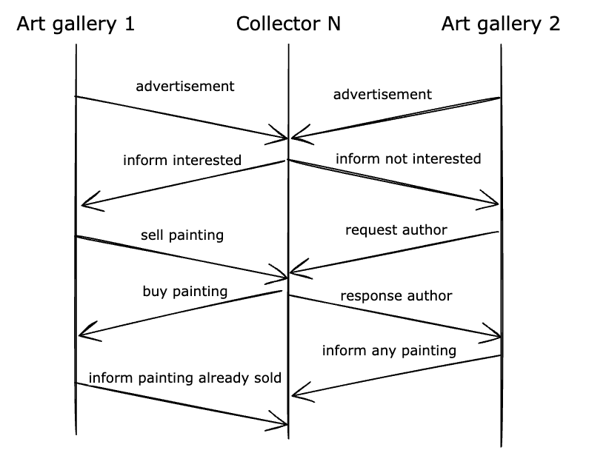
Interaction protocols. Worst cases
This diagram represents the worst cases of our communication protocol, where the collector N is interested in a painting from one of the galleries and not interested in the other’s. However, the painting they’re interested in is already sold.
In these cases, each agent is unsatisfied.

Slide 8
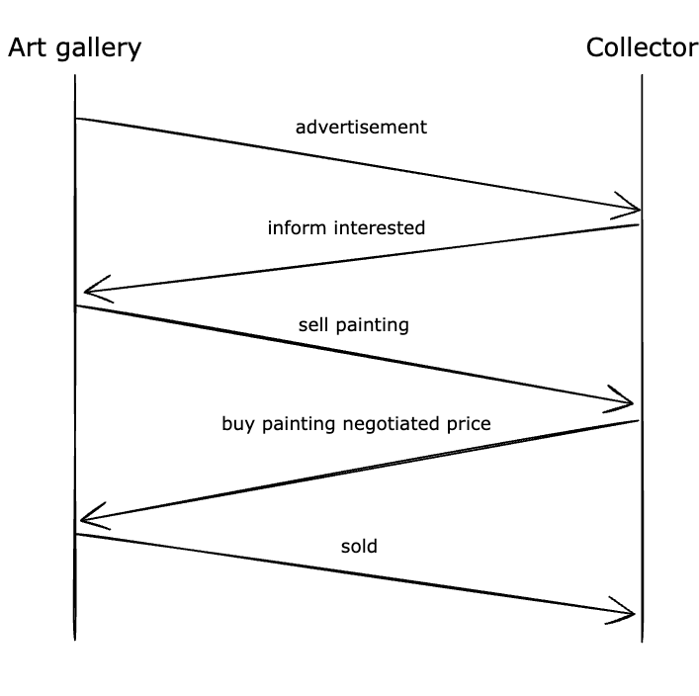
Interaction protocols. Negotiation
This diagram represents the negotiation between the art gallery and the collector:
The art gallery sends an advertisement to the collector. Then, the collector sends a response informing that they’re interested in the painting.
Once they’ve negotiated, the art gallery sells the painting to the collector, who buys it at the accorded price.
Finally, the painting is sold.

Slide 9
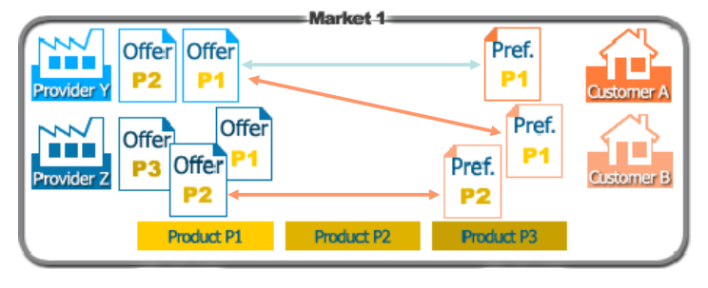
Interface design
We based our interface design on the theory slides of the subject.

Slide 10
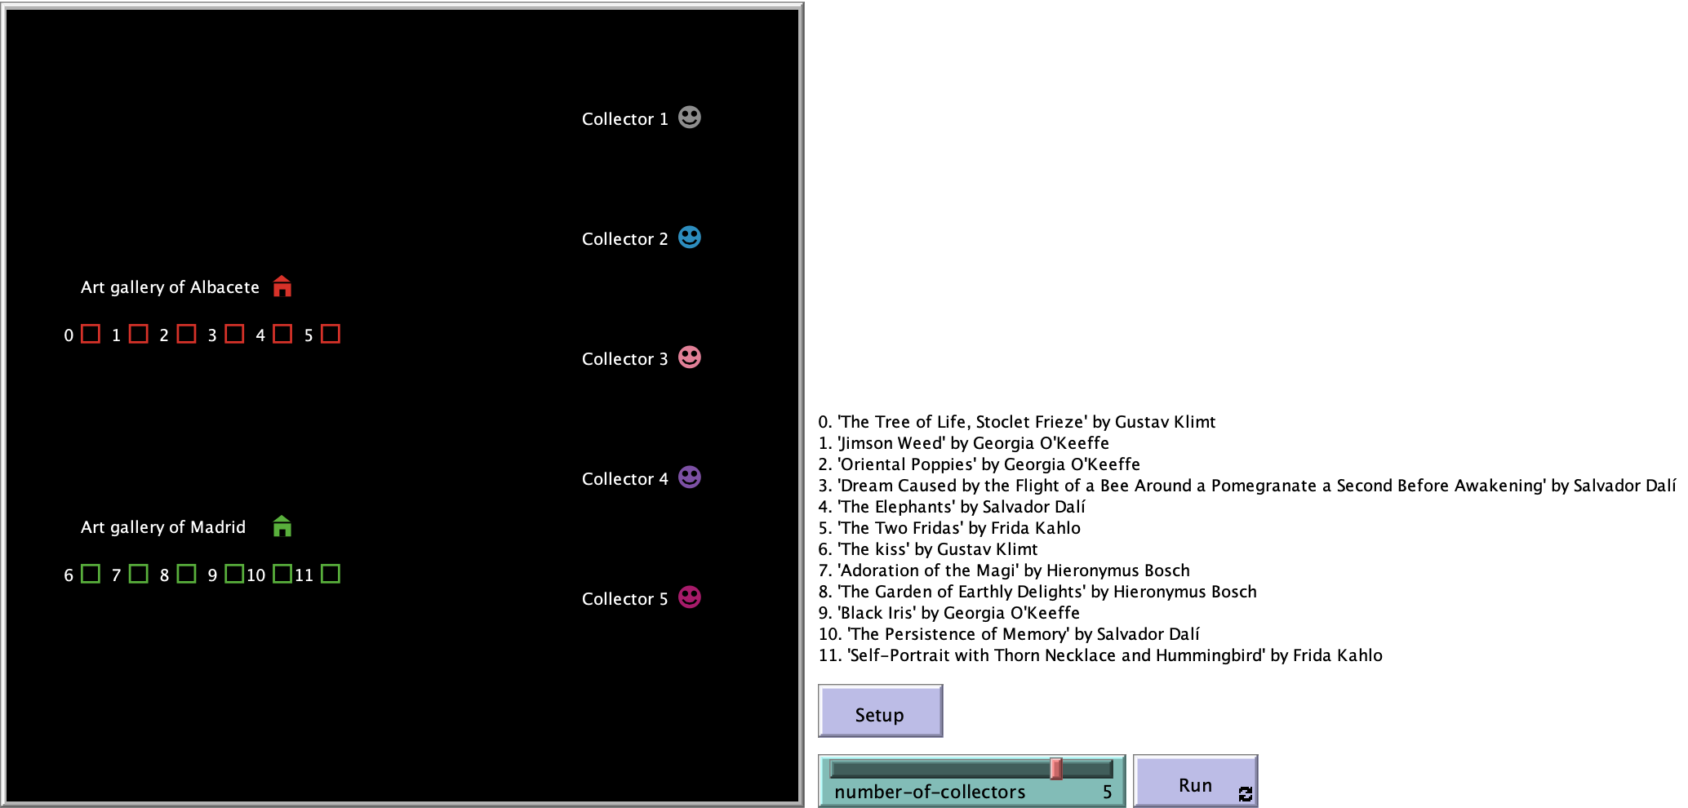
Interface design. Simulating the negotiation

Slide 11
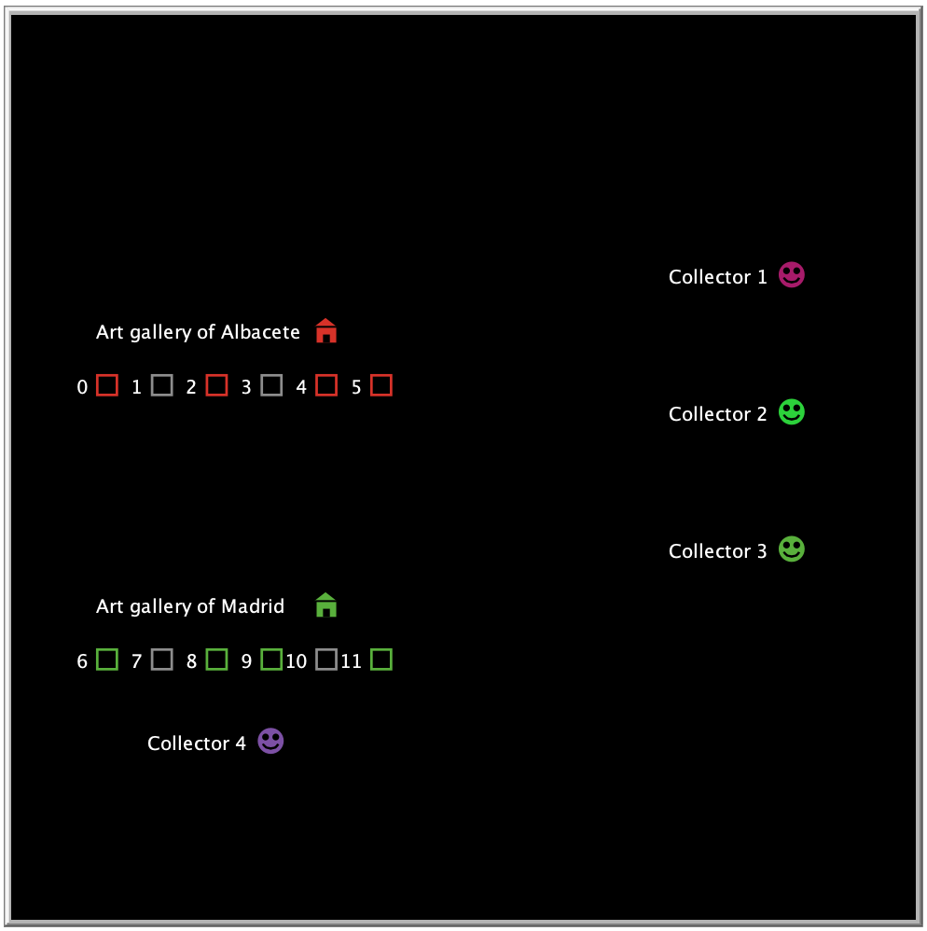
Interface design. Galleries, paintings and collectors
Each gallery is represented by a house icon (red or green) on the left, and their paintings are represented by squares (again, red or green).
Each collector, which are represented by the smiling faces on the right, moves to the gallery where the painting they’re interested in is.
Once they’re there, the collector and the gallery start dialoguing in order to make a fair deal. If the result is a sold, the costumer gets the painting (and its corresponding square is turned grey).

Slide 12
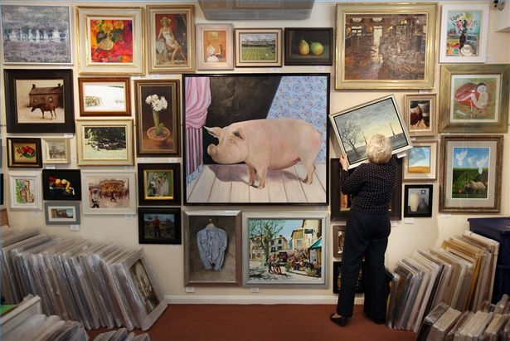
Experiments and results
We have based the tests on the variation in the number of collectors.

Slide 13

Experiment with one collector
Each collector can get a maximum of two paintings, because there are only two art galleries that contact them.

Slide 14
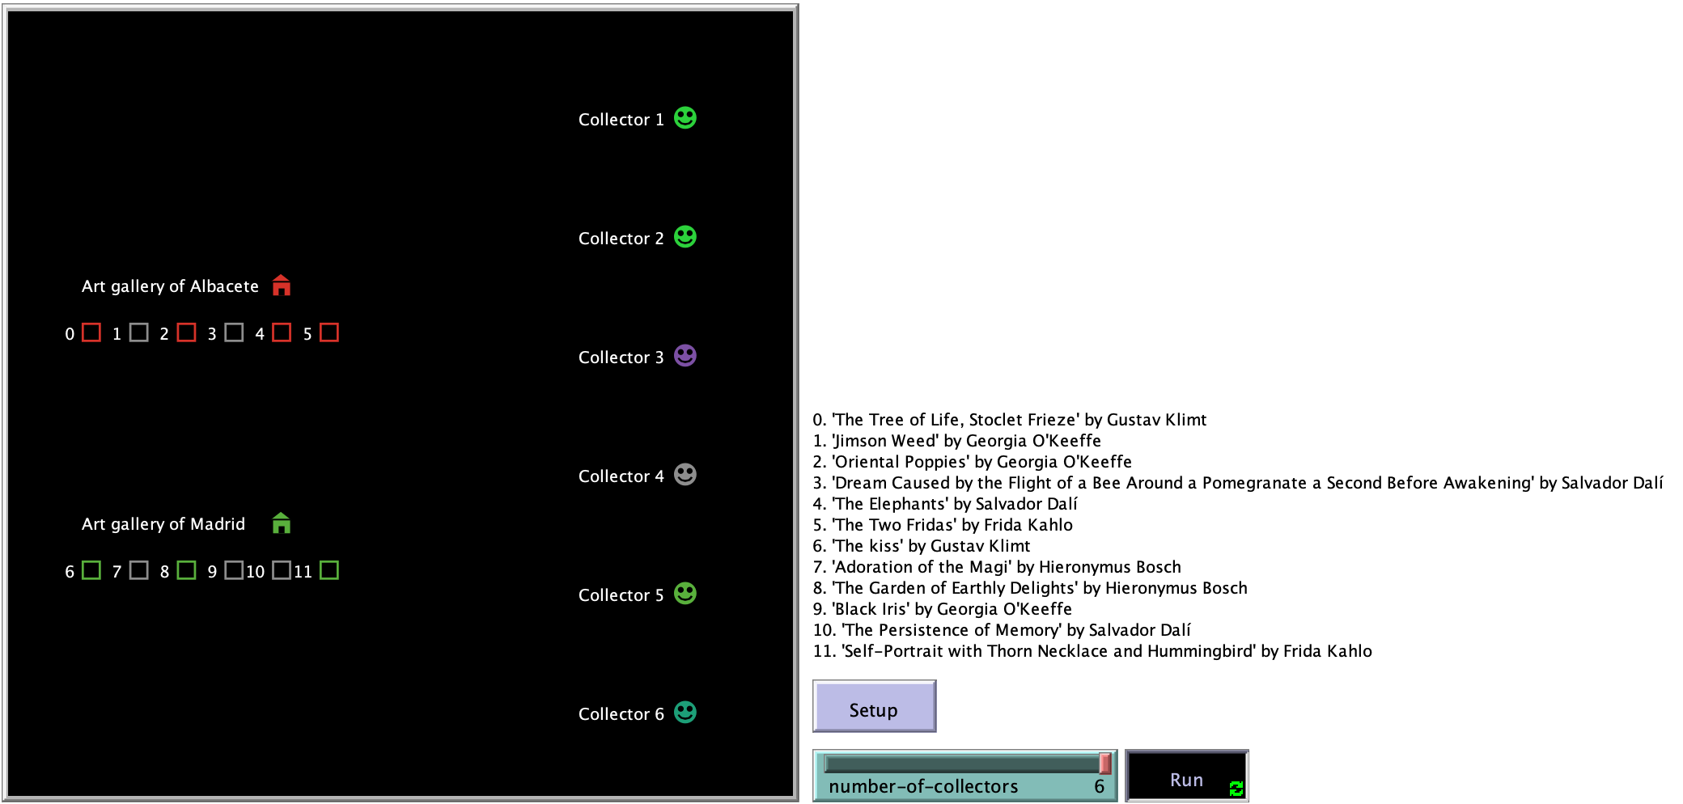
Experiment with six collectors
More collectors means more probability to sell paintings, which means better performance of the market.

Slide 15

Analysis and conclusions
The global behaviour matches with our expectations.
With these simulations, we have learned the importance of reaching the maximum number of clients in a market and matching their preferences with the products a seller has.
In conclusion, the performance of our market is higher when there are more collectors.

Slide 16
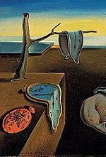
Future work
The model could be improved by adding the following features:
Possibility to increase the number of collectors to a much higher value (thousands and thousands), as well as the number of galleries, so the art market would be a bit more realistically represented.
Add, in some way, an additional value to the paintings, because its value it’s not only monetary, but also subjective to the collector or the art gallery.
Take galleries, collectors and paintings features from a real database, again to represent the market in a fairer way.

Slide 17
The
End

